Slide 1
Lesson 2: What is the recipe for empire?
A comparative analysis of
Era 3 empires

Slide 2
Talking to the Text:
As you read, think about what is most important in each section.
Underline or highlight details and ideas that seem most important in each section, or jot them on sticky notes and place the sticky notes on the page.
FOCUS ON DETAILS OR IDEAS THAT HELP YOU ANSWER THE DRIVING QUESTION… WHAT DOES IT TAKE TO FORM AN EMPIRE?

Slide 3
Talking to the Text Modeling:
In Era 3, the majority of the world’s people probably did not live inside of empires. Some lived in city-states, which were relatively small independent territories centered on a single city. Many other people lived under no state authority but in societies organized in kinship groups.
Nevertheless, a sweeping view of Afroeurasia at about 100 CE reveals a nearly continuous chain of states, most of them gigantic, extending from the Atlantic to the Pacific. All these states enjoyed extended periods of political order and economic prosperity, and those conditions in turn stimulated long-distance exchanges of products and ideas, not just within states but between one empire and another.
http://worldhistoryforusall.sdsu.edu/eras/era4.php#land

Slide 4
Talking to the Text Modeling:
Empires were NOT small city-states.
In Era 3, the majority of the world’s people probably did not live inside of empires. Some lived in city-states, which were relatively small independent territories centered on a single city. Many other people lived under no state authority but in societies organized in kinship groups.
Nevertheless, a sweeping view of Afroeurasia at about 100 CE reveals a nearly continuous chain of states, most of them gigantic, extending from the Atlantic to the Pacific. All these states enjoyed extended periods of political order and economic prosperity, and those conditions in turn stimulated long-distance exchanges of products and ideas, not just within states but between one empire and another.
http://worldhistoryforusall.sdsu.edu/eras/era4.php#land
Empires were NOT places with no state authority, so they had state authority (government).
Empires had political order and economic prosperity.
Empires had trade internally and with other empires.

Slide 5
Student Handout 7- Expert Group Note Tracker: Empire ________________
Characteristic | Significant information about this empire related to this characteristic:
Background/ location
Founding
Organization
Religion
Trade
Decline/Fall
Summary description / categorization of this empire

Slide 6
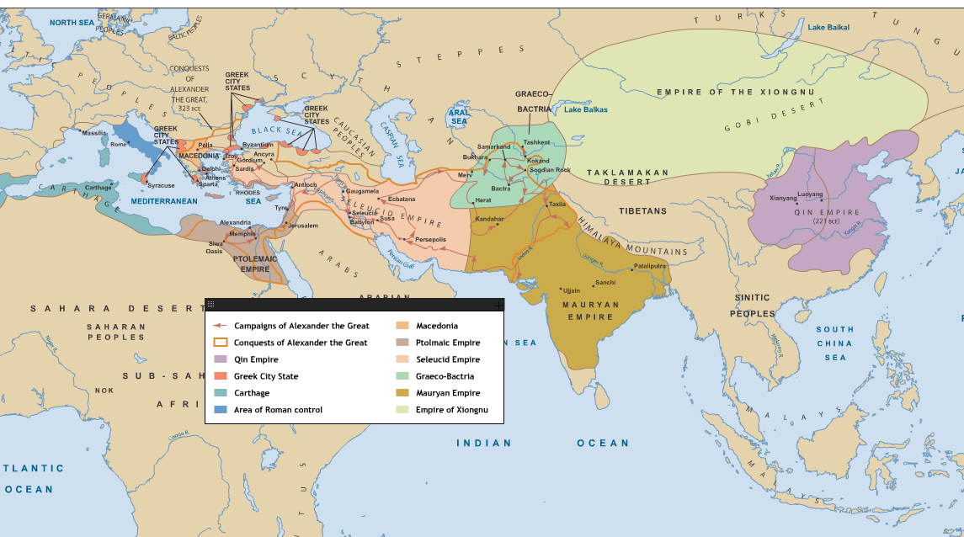

Slide 8
Peer Teaching Group Process:
Going in the chronological order of empires, take turns teaching others by:
Sharing the name of your empire
Showing and explaining the symbol(s) or illustration you designed to represent your empire
Explain the key information you learned about your empire for each category.
Ask your group members if they have any questions.
Check their understanding by asking two different team members to tell you in their words what this empire did or needed to become an empire.

Slide 9
Empire Comparison Organizer
Empire | Background | Founding | Organization | Religion | Trade | Decline/Fall
Persian
Athenian
Alexander
Ptolemaic
Seleucid
Mauryan
Common Features
What is the recipe for an empire? | Ingredients and amounts (order of importance) Directions (order and steps in which you use the ingredients):
So... what is an empire?

Slide 10
Turn and Talk: In this lesson, we are not discussing the empires that existed in China, for example, the Qin and Han Empires. Study the map above. Why might the Chinese empires have been less connected to the cycle of rising and falling empires we learned about in this lesson?

Slide 11
Property of Oakland Schools
Authors: Stacie Woodward and Darin Stockdill
Editor: Amy Bloom

